Slide 1

Kobe Shot Prediction
Minke Cheng, Meng Lin, Yi Zhang, Chiaju Chen

Slide 2
Content
Background
Data exploration and feature selection
Proposed feature transformation methods
Training and predicting
Conclusions

Slide 3
I. Background
Kobe Bryant
One of the greatest basketball player in the history
Position: shooting guard
Playing career: 1996-2016
Data Source:
Kaggle competition https://www.kaggle.com/c/kobe-bryant-shot-selection/data
Containing 24 features of every attempt made by Kobe during his 20-year career.
Training data size: 25697 Predicting data size: 5000
Given around 84% of my 20 year-data on shooting, can you predict the remaining single shot?! How about this one?

Slide 4
I. Background
Possible solution:
Data visualization
Domain knowledge of basketball game
Feature transformation
Trial and error
Key challenges in the our studied problem
How to deal with various categorical features?
Constraint on number of feature and size of dataset
Redundant features or hidden information
There are peaks and troughs during Kobe’s 20-year career. How this information could be employed for prediction?
Easy question does not imply a perfect solution

Slide 5
Content
Background
Data exploration and feature selection
Proposed feature transformation methods
Training and predicting
Conclusions

Slide 6
II. Data exploration and feature selection
An overview of 24 available feature
1. Action related | shot type | categorical (55)
 | combined shot type | categorical (6)
2. Location related | location x, location y, latitude, longitude | discrete scalar value
 | shot zone basic/range/area | categorical (5,6,6)
 | shot distance | scalar value
 | 3 field point indictor | categorical (2)
3. Time related | period | categorical (4)
 | season | categorical (20)
 | remaining second | categorical (60)
 | remaining minutes | categorical (12)
4. Other factor | game type (playoffs or regular), host or visit, opponent, game date
5. Irrelevant factor | team id, team name, game id, game event id

Slide 7
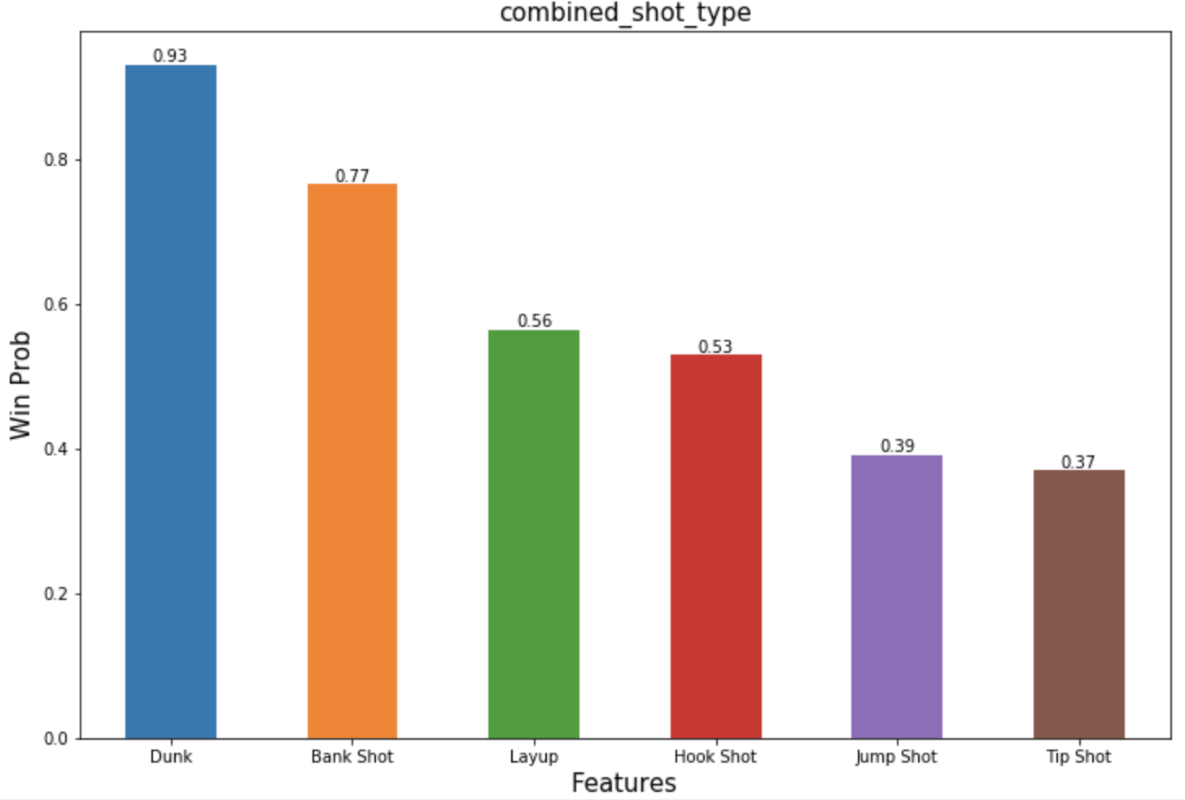
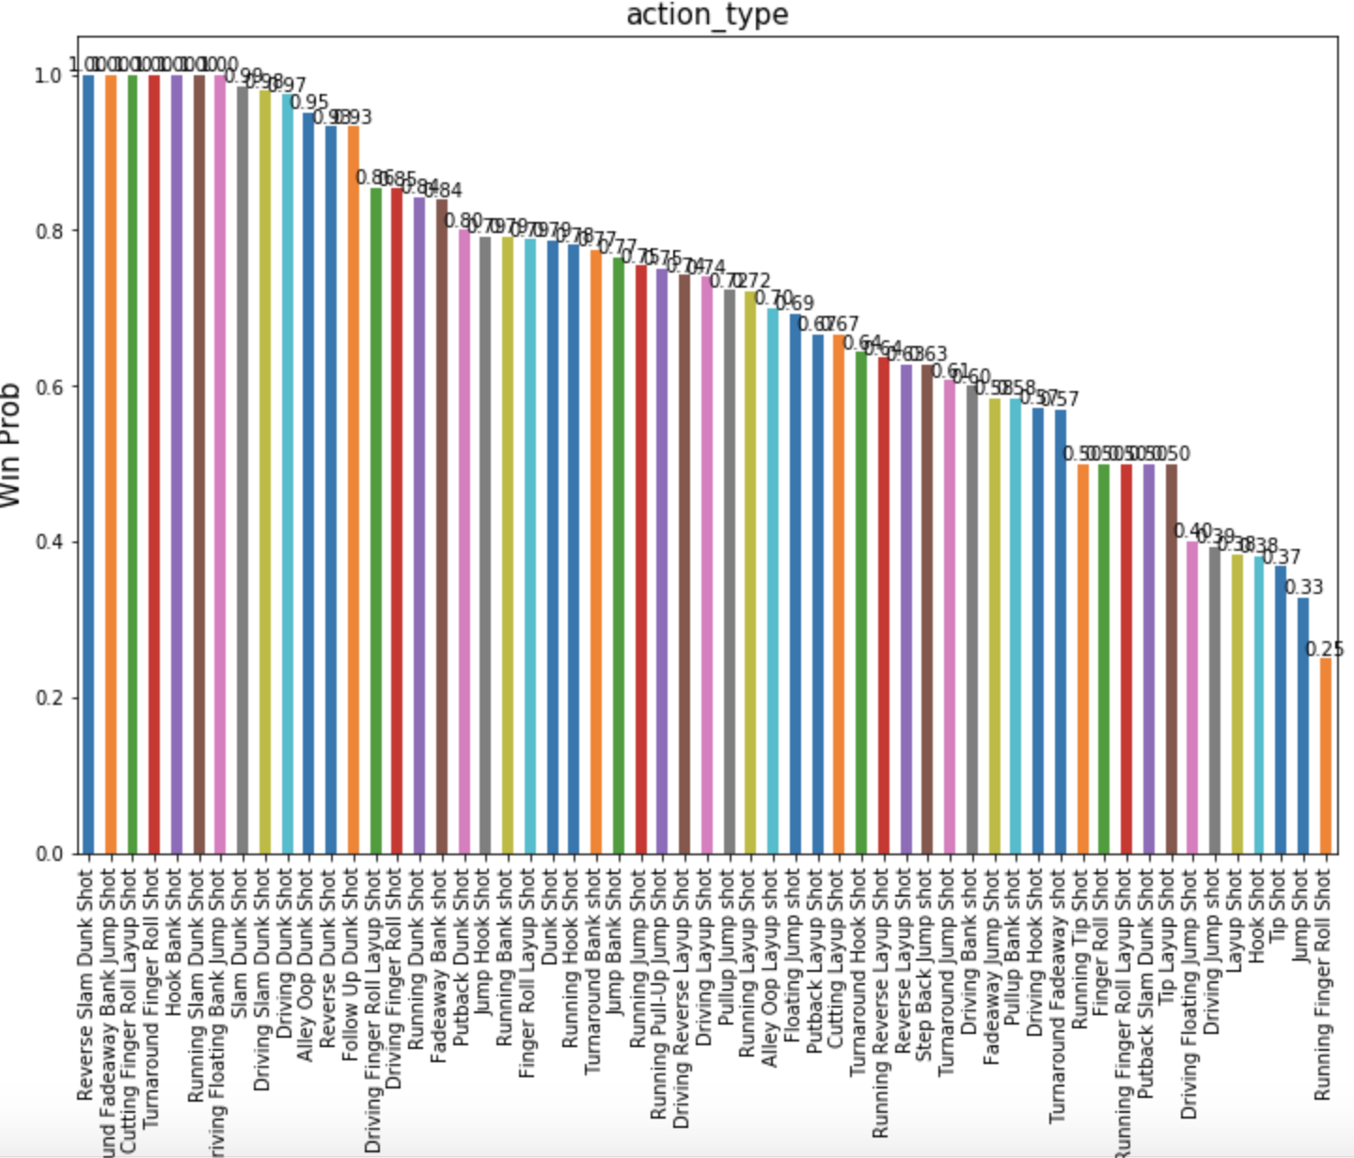
II. Data exploration and feature selection
Type1: Action related features
Fig.2 Accuracy vs combined shot type (6 categories)
Observations:
Different shot actions have different accuracies
Combined shot type is a coarse cluster of shot action type
Fig.1 Accuracy vs shot type (55 categories)

Slide 8
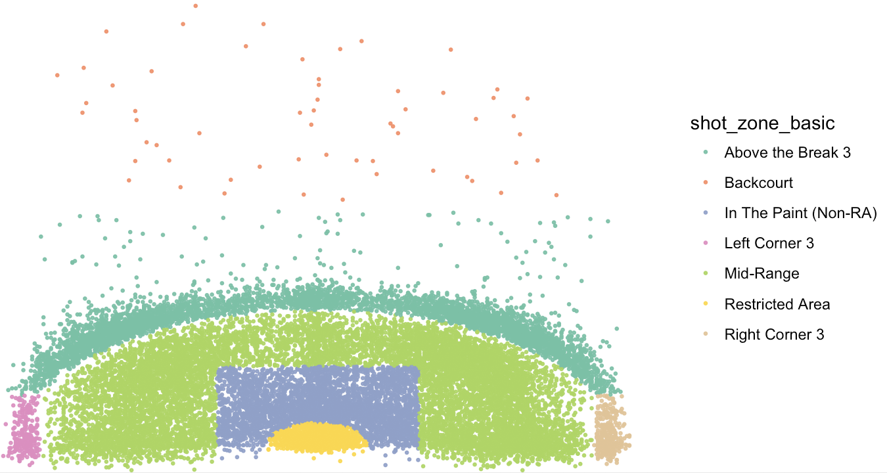
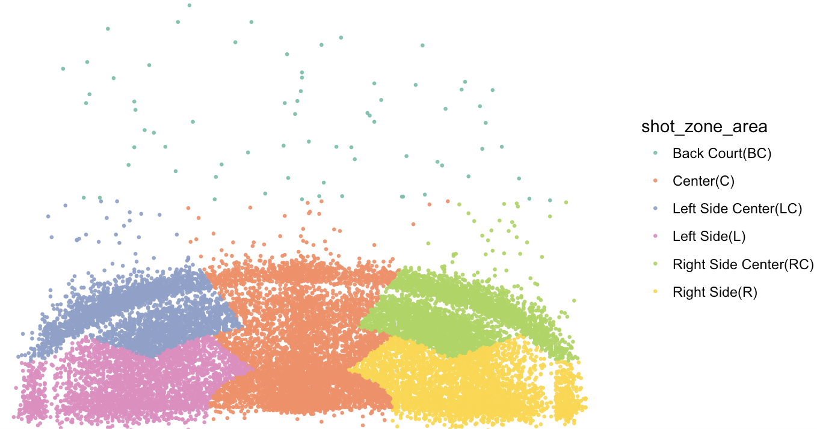
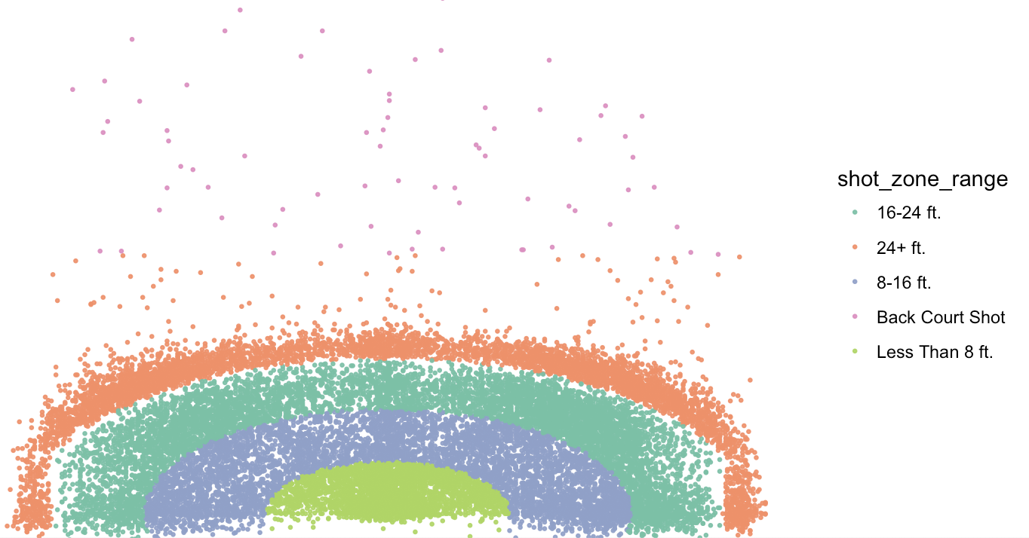
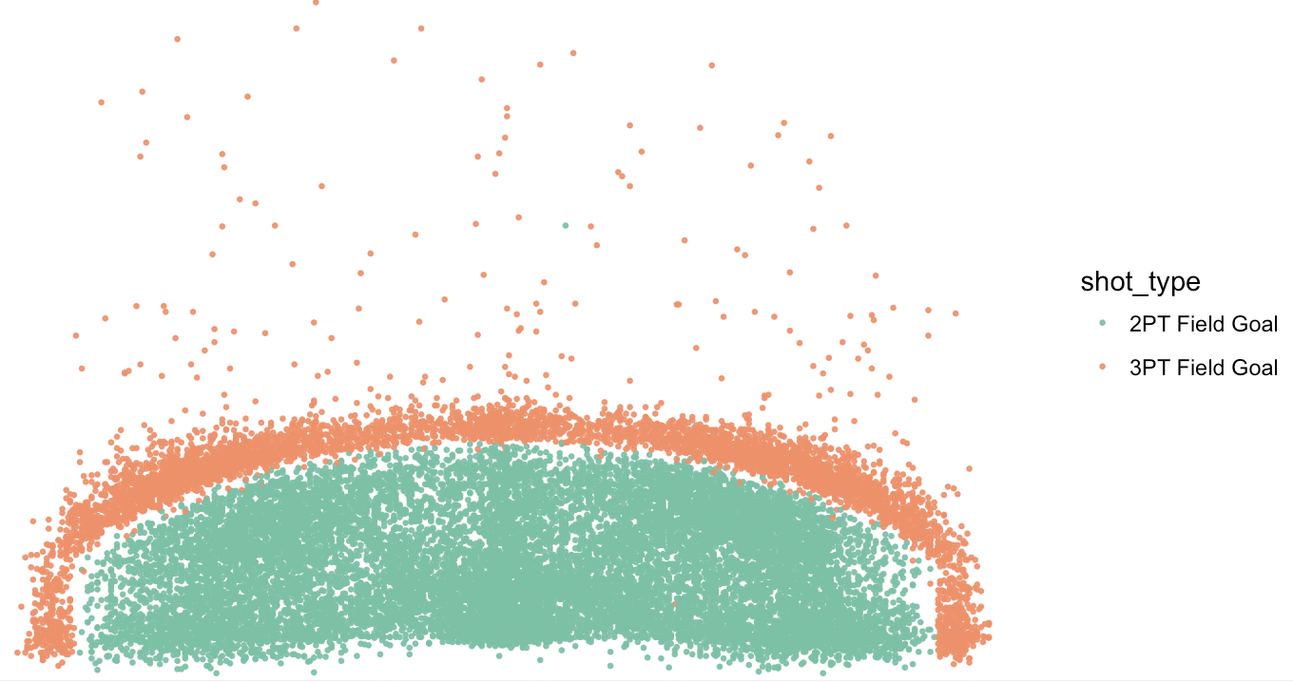
II. Data exploration and feature selection
Type2: Location related features (number of attempts)
Fig.3 Shot zone area (6 categories)
Fig.4 shot zone basic (7 categories)
Fig.5 Shot zone range (5 categories)
Observations:
These 4 features are different partitions of a court
They characterize court from different perspective with a more focus on domain knowledge
There exists redundancy between features
Which feature is best is unknown
Fig.6 3PT Field indicator (2 categories)

Slide 9
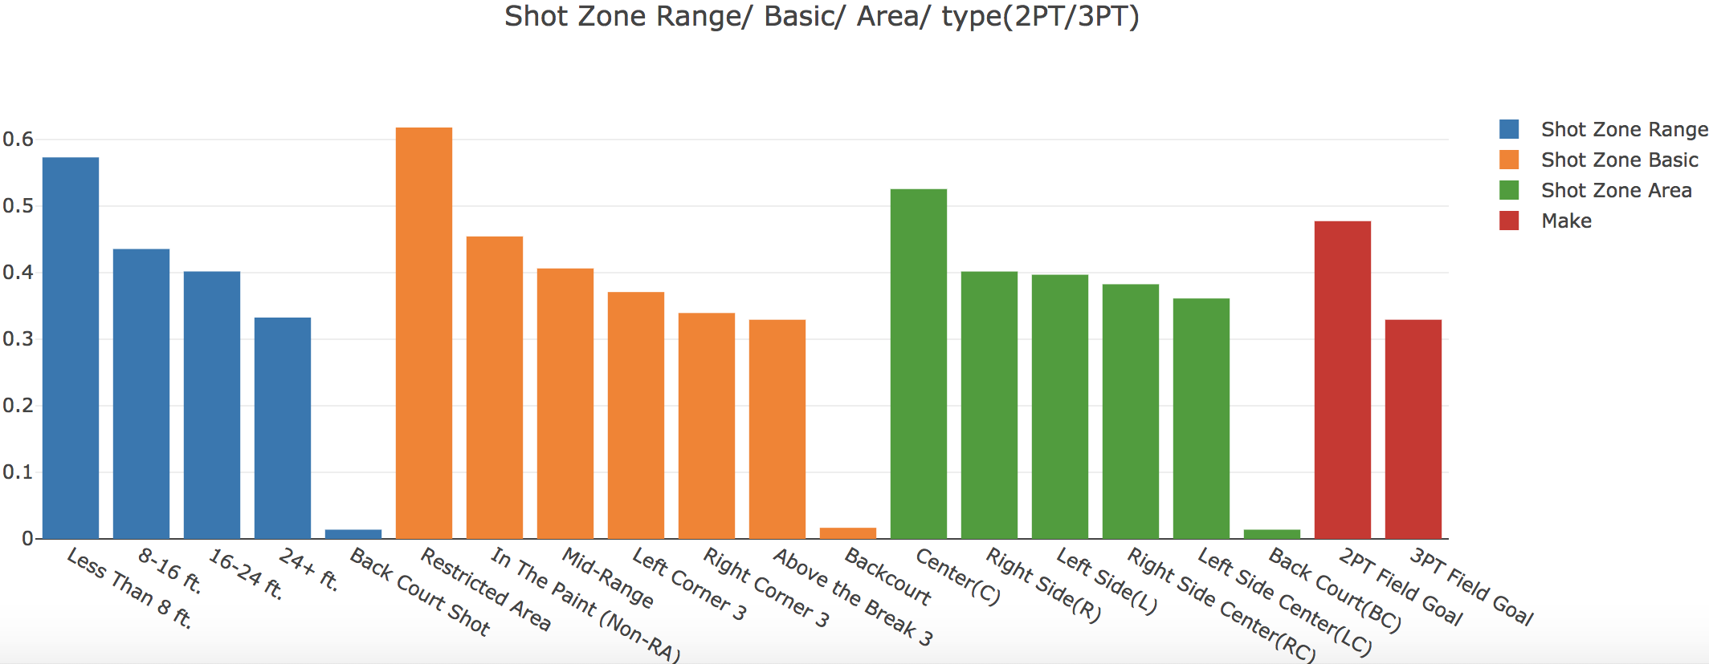
II. Data exploration and feature selection
Type2: Location related features (accuracy)
Fig.7 Accuracy vs different location of the court
Observations: they all seem to be useful data

Slide 10
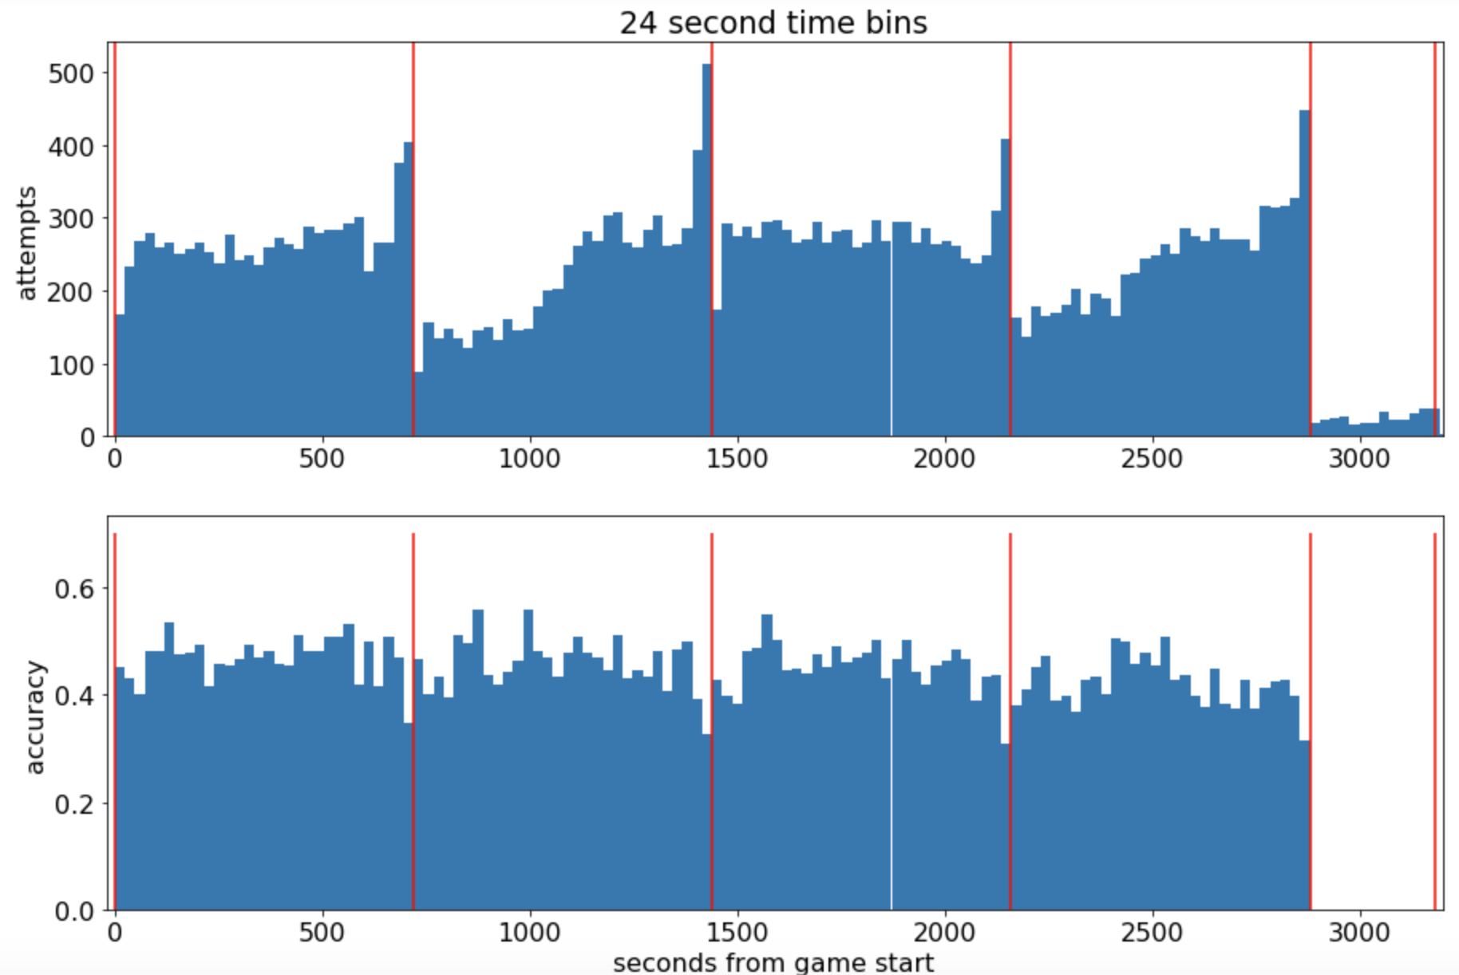
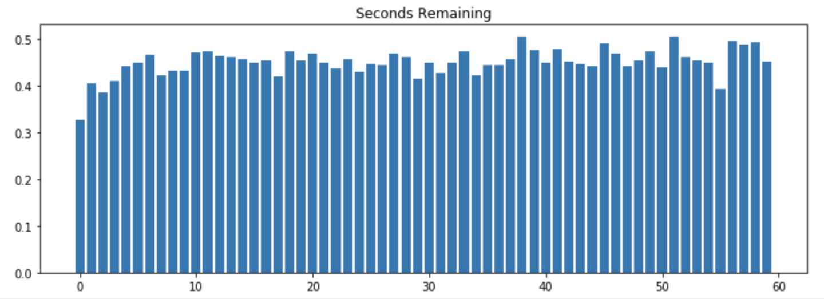
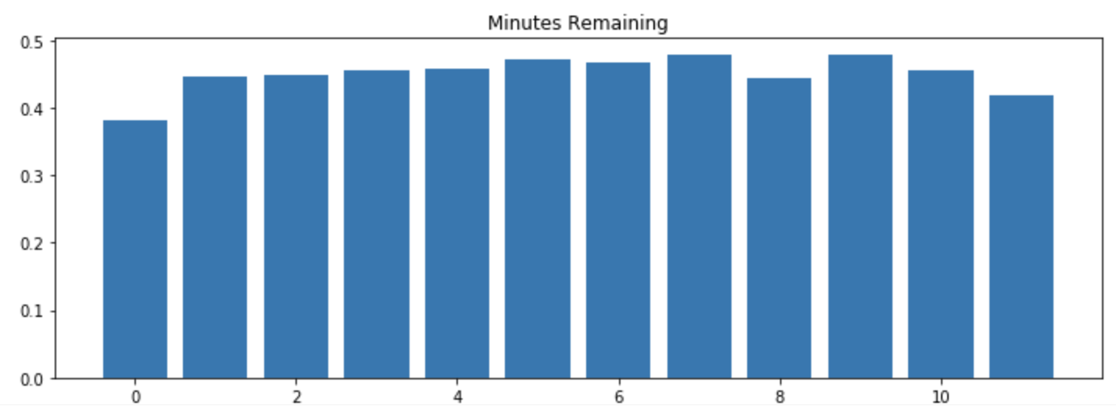
II. Data exploration and feature selection
Type3: Time related features
Fig.8 Accuracy vs remaining seconds
Fig.10 Attempts and accuracy vs time remaining
Observations: hidden pattern seems to exits
Fig.9 Accuracy vs remaining minutes

Slide 11
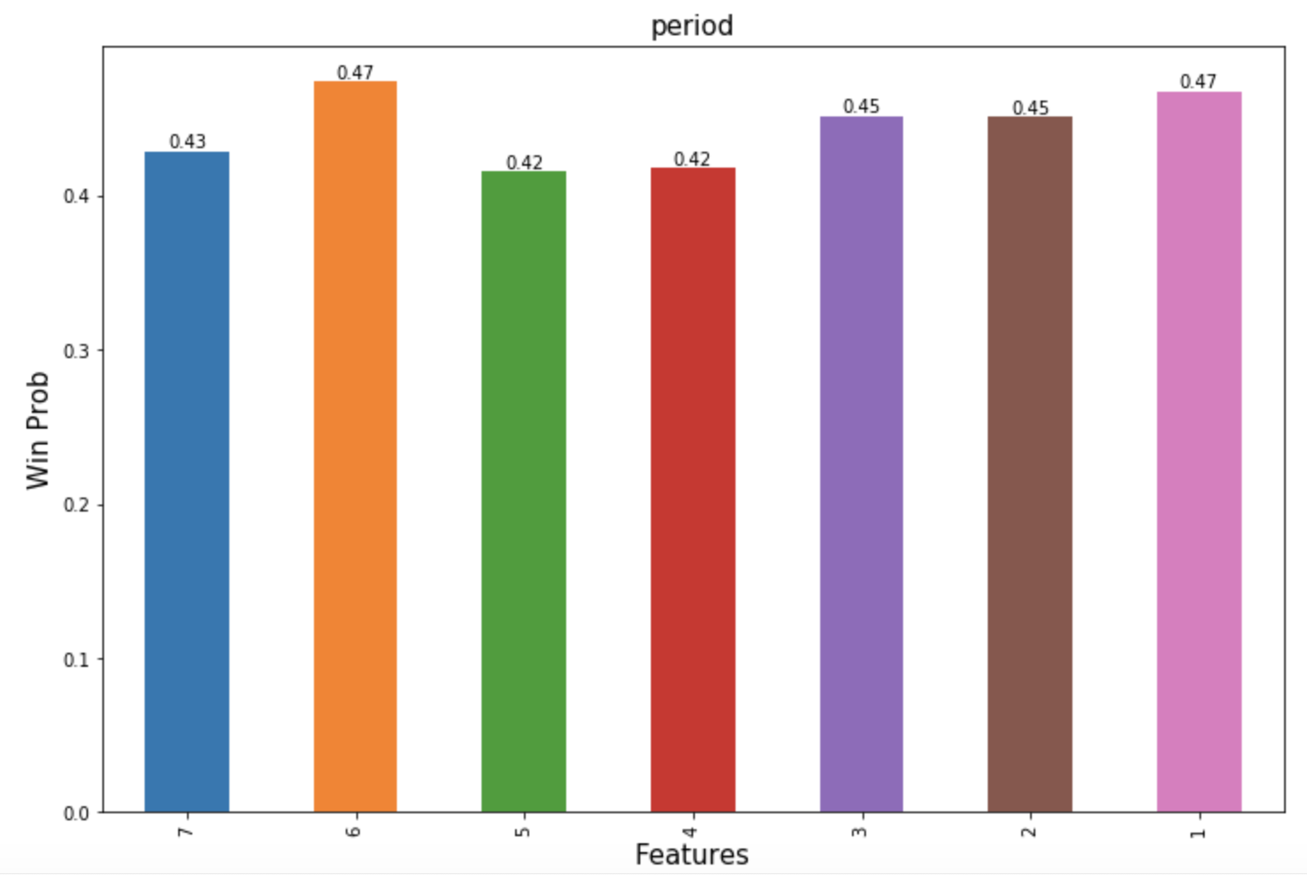
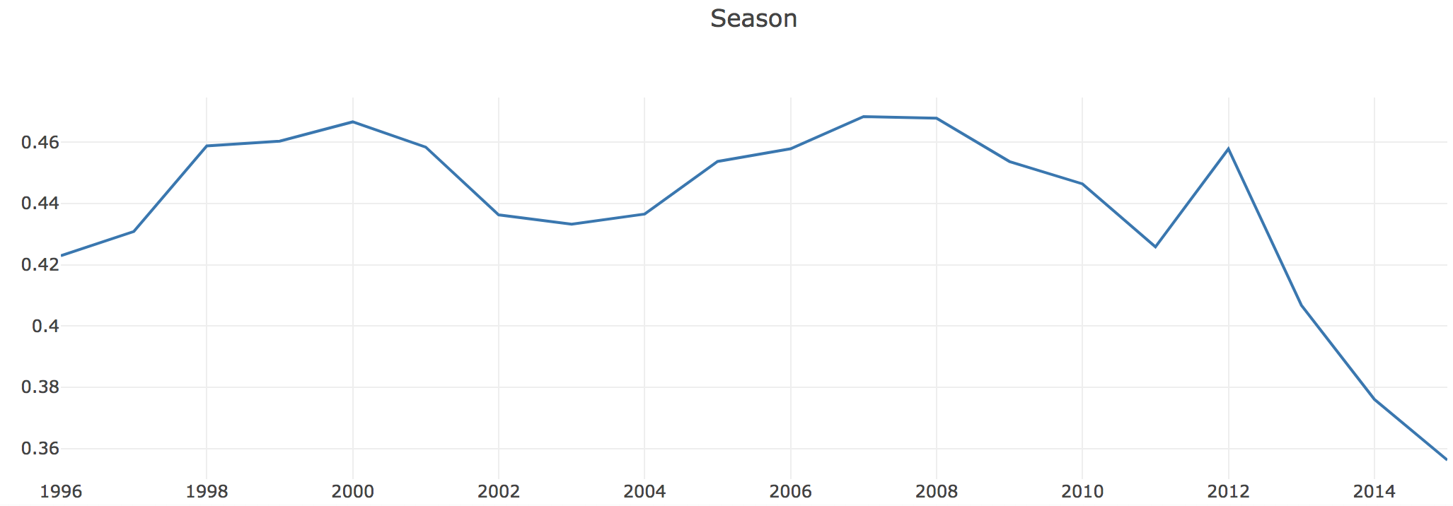
II. Data exploration and feature selection
Type3: Time related features
Kobe Bryant sexual assault case
Later period of career
Fig.11 Accuracy vs period
Observations:
Season is an important feature!
Fig.12 Accuracy vs game season

Slide 12
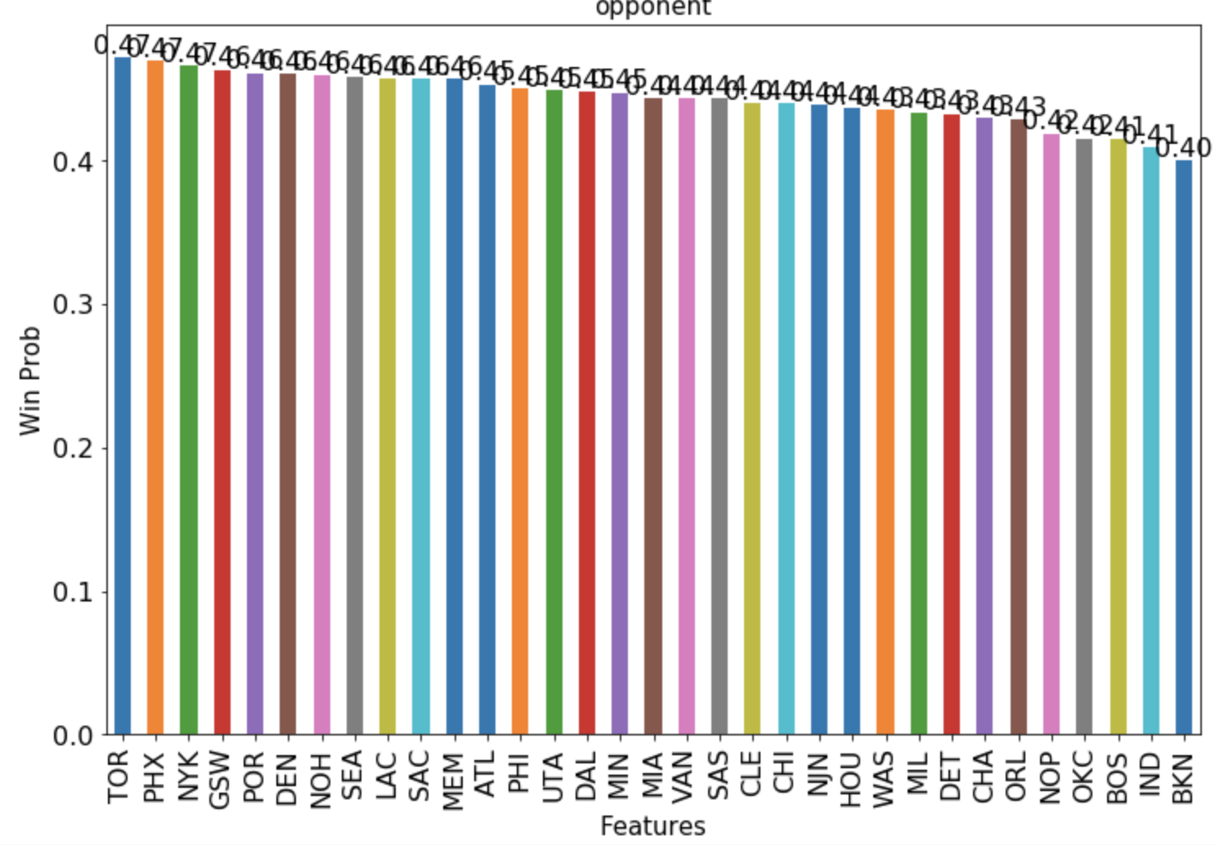
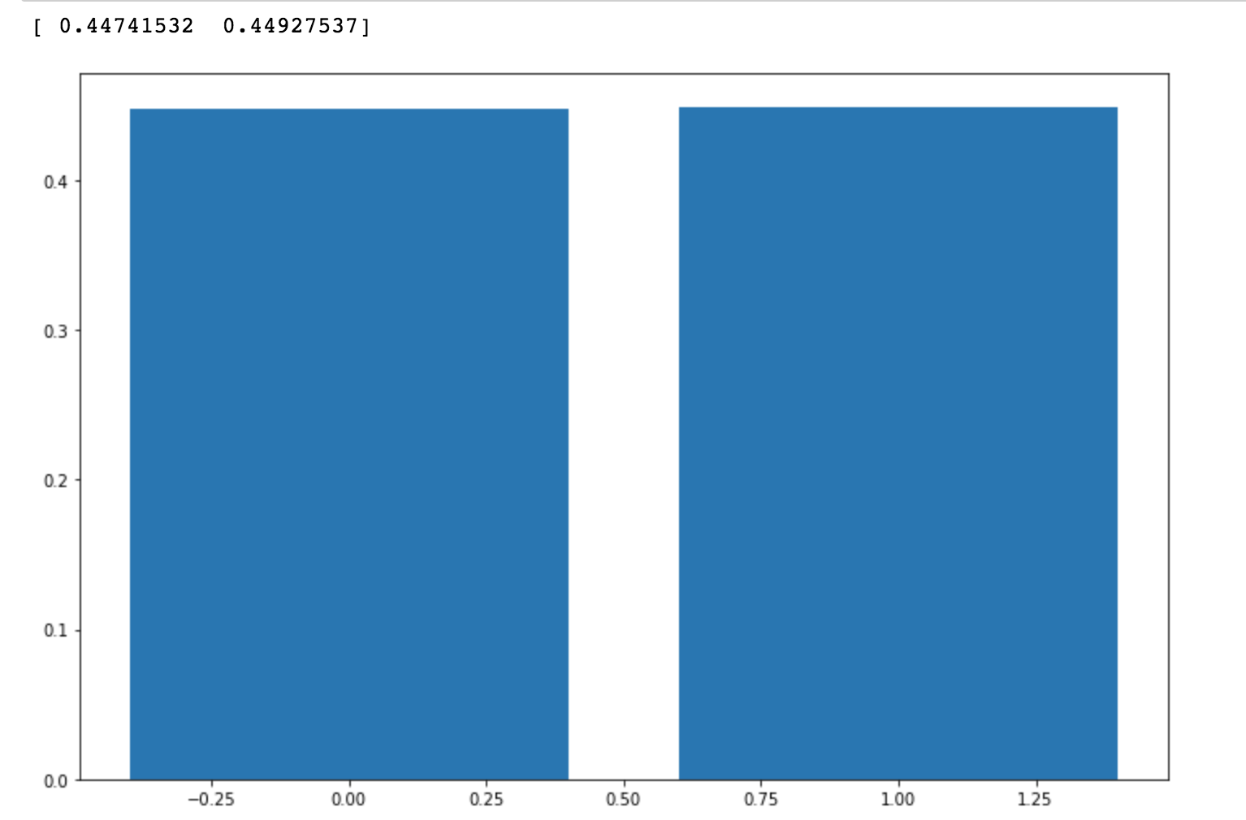
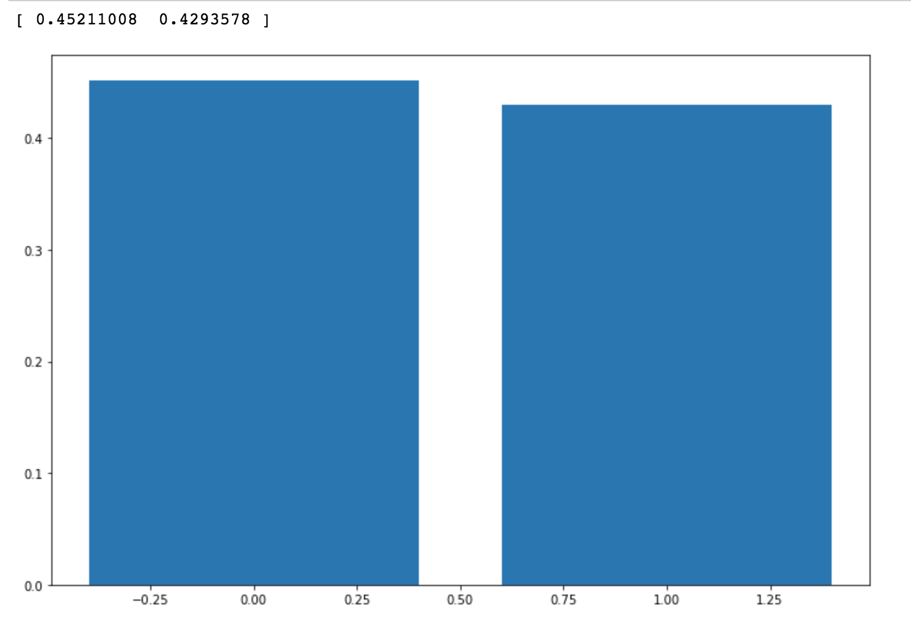
II. Data exploration and feature selection
Type4: Other factors
Fig.13 Accuracy vs host or visit
Fig.14 Accuracy vs game type (playoffs and regular)
Fig.12 Accuracy vs opponents
Observations:
1. No big differences between categories within some features
2. Kobe keeps similar performance in both playoffs and regular games and home/visit game does not impact its performance (these are what super stars always be like, i.e. big heart)

Slide 13
Content
Background
Data exploration and feature selection
Proposed feature transformation methods
Training and predicting
Conclusions

Slide 14
III. Proposed feature transformation methods
Spatial features
Shot zone area
Shot zone basic
Shot zone range
Shot type
longitude, latitude
shot distance
Temporal features
Minutes
Seconds
Period
Season,
Shot action type
action type
combined action type
1. Dummy coding
2. KNN based feature clustering
3. Quantization and clustering
Data
exploration

Slide 15
III. Proposed feature transformation methods
Spatial features
Shot zone area
Shot zone basic
Shot zone range
Shot type
longitude, latitude
shot distance
Temporal features
Minutes
Seconds
Period
Season
Shot action type
action type
combined action type
1: Dummy coding Dummy coding for variables with only a few categories

Slide 16
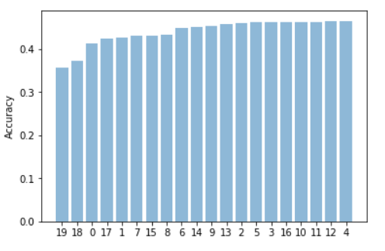
III. Proposed feature transformation methods
2: KNN based feature clustering
Principle: cluster categories by accuracy
Spatial features
Shot zone area
Shot zone basic
Shot zone range
Shot type
longitude, latitude
shot distance
Temporal features
Minutes
Seconds
Period
Season
Shot action type
action type
combined action type
Dummy coding
Step 1
Calculate accuracies of each category of a feature
Step 2
Cluster accuracies into certain groups
Step 3
Dummy code groups
Group 4
Group 3
Group 2
Group 1
Fig.15 KNN based feature clustering

Slide 17
III. Proposed feature transformation methods
3: Quantization and clustering
Principle: calculate accuracies of quantized variable
Spatial features
Shot zone area
Shot zone basic
Shot zone range
Shot type
longitude, latitude
shot distance
Temporal features
Minutes
Seconds
Period
Season
Shot action type
action type
combined action type
Quantize continuous feature
Calculate accuracies of each quantized level
Accuracy-based feature clustering
Direct usage it as a feature

Slide 18
Content
Background
Data exploration and feature selection
Proposed feature transformation methods
Training and predicting
Conclusions

Slide 19
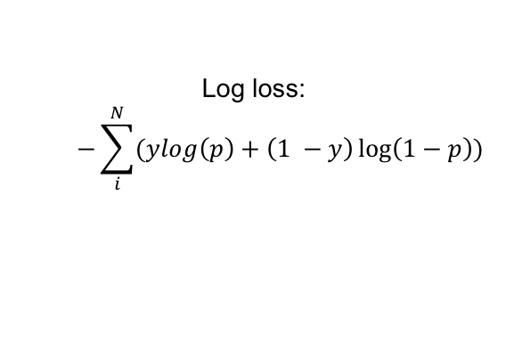
IV. Training and predicting
Model | Log loss | Accuracy | ROC Scores | Rank in Kaggle (Log loss)
Logistic Regression | 0.609771 | 0.680200 | 0.696475 | 507/1117
Decision Tree (gini/entropy) | 0.624794 | 0.679800 | 0.671010 | 697/1117
Random Forest | 0.614181 | 0.669800 | 0.699371 | 614/1117
AdaBoost | 0.671602 | 0.679800 | 0.681971 | 852/1117
GBDT | 0.607023 | 0.679600 | 0.704722 | 398/1117
XGBoost | 0.603079 | 0.681000 | 0.708519 | 268/1117
Log loss:
$$−\sum_{i}^{N}{(ylog\left(p\right)+\left(1 −y\right)\log\left(1−p\right))}$$

Slide 20
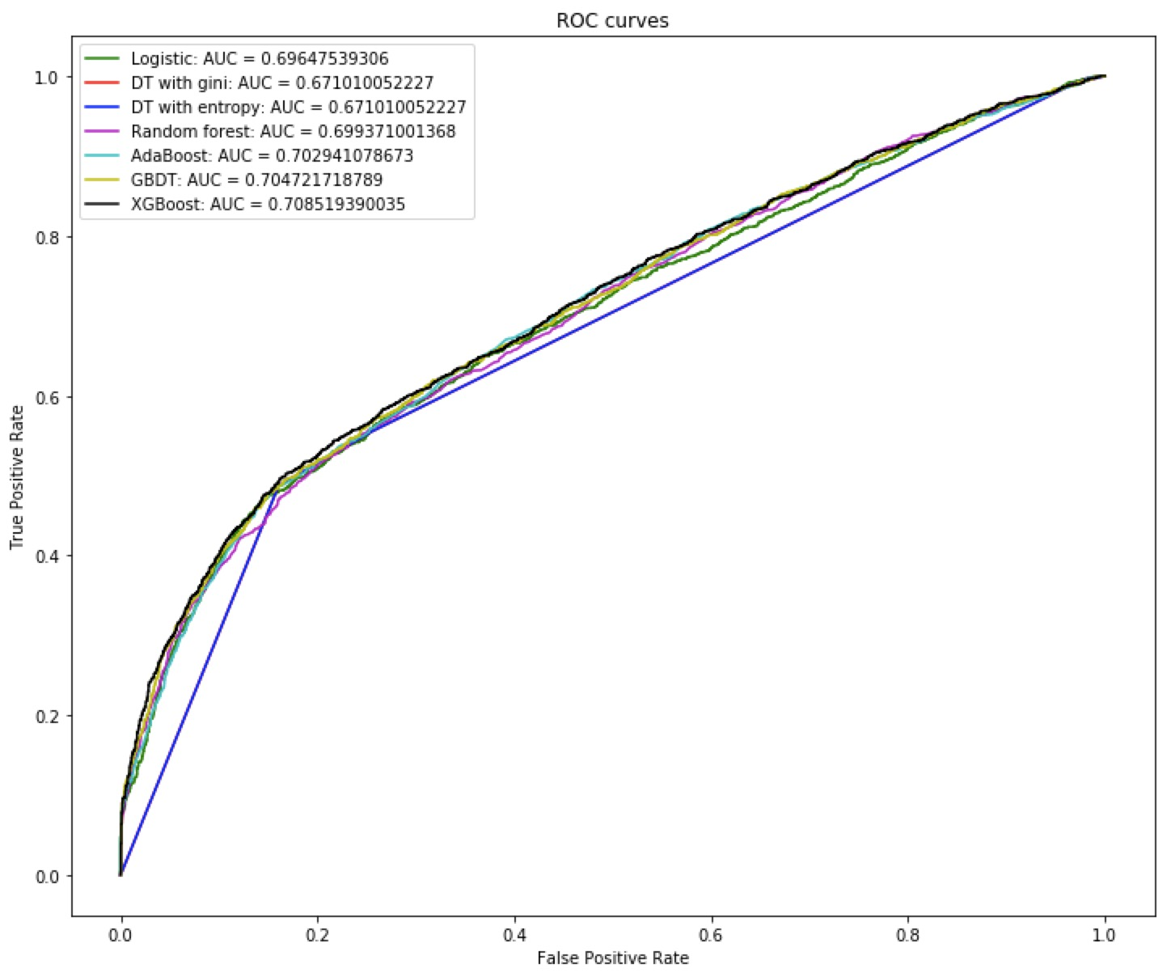
IV. Training and predicting

Slide 21
Content
Background
Data exploration and feature selection
Proposed feature transformation methods
Training and predicting
Conclusions

Slide 22
V. Conclusions
Lessons Learned
Feature selection is important
Useful features selected by visualization
Alternative choice: Recursive feature elimination (trial and error method)
A good feature improves far more significant than parameter tuning
Dummy coding
Powerful technique for treating categorical variable
Feature transformation
Proposed KNN based feature clustering---explore hidden feature pattern
Good transformation reveal more of data

Slide 23
V. Conclusions
Future work
Prediction based on timing
Make prediction on one event using data prior to it.
Small sample category
One action type may own higher shot rate while with small sample numbers.
Combine multiple models
For metrics such as accuracy, combining different models may give higher score. Voting classifiers.
Joint analysis
Can we find similarities among multiple players?

Slide 25
Quantize continuous feature
Calculate accuracies of each quantized level
Accuracy-based feature clustering
Direct usage it as a feature

